Slide 1
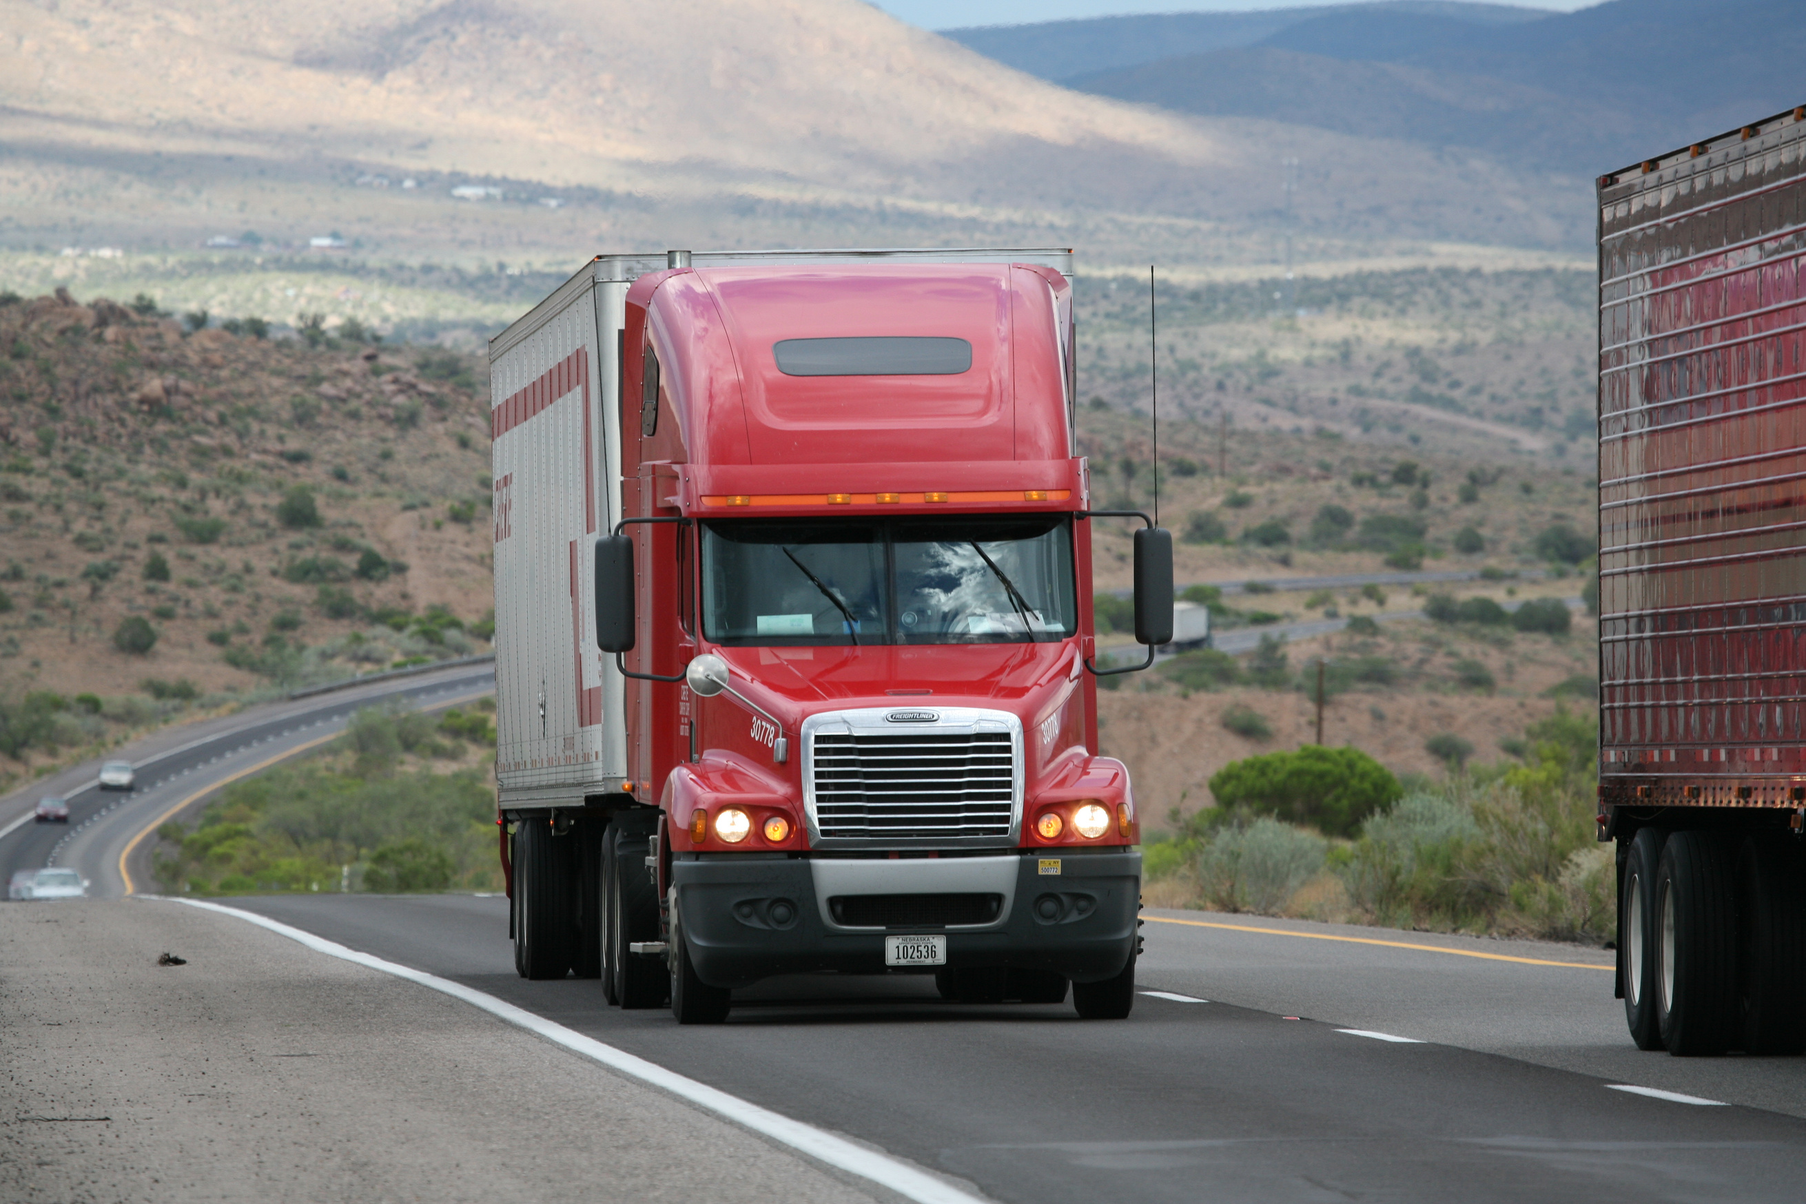

USING MIP TO
OPTIMIZE DELIVERY ROUTES FOR A LOCAL
DELIVERY COMPANY
GB730 APPLICATION PROJECT - MAI NGUYEN

Slide 2

Why Route Optimization Matters
Problem:
Small delivery companies face rising pressure
Customers expect fast delivery, fuel costs keep climbing, and traffic conditions shift constantly
When a company assigns drivers manually or uses a basic system, routes end up longer than they need to be
=> That leads to wasted fuel, slow deliveries,
overtime pay, and unhappy customers
Goal:
Design an optimization model that calculates the most efficient route plan that still respects real operational limits

Slide 3
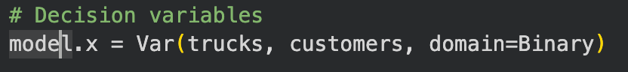
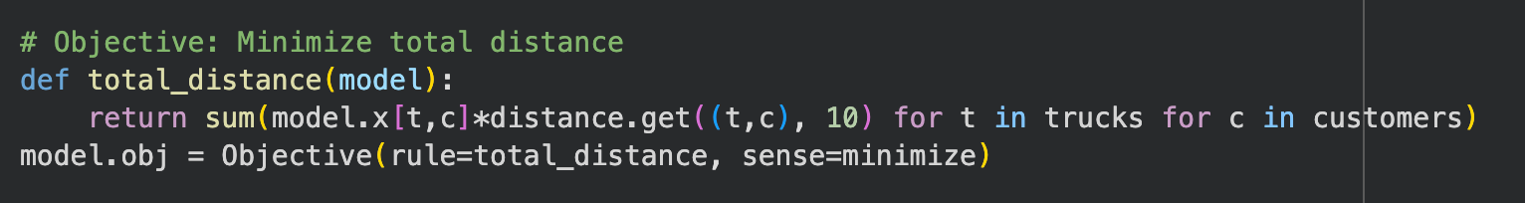
Objective Function
Minimize total distance travelled by trucks while delivering for customers for their packages
Solver:
Pyomo with CBC solver (MIP)

Slide 4
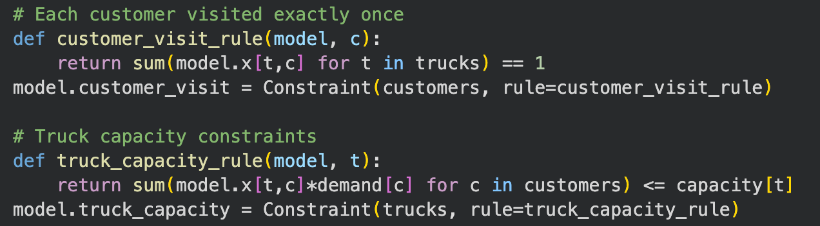
Variables & Constraints
Variables:
Binary Variables (yes or no decisions)
model.x[t,c] = 1 if truck t delivers to customer c, 0 otherwise
Determines which truck visits which customer
Contraints:
Trucks Capacity
There is only 5 trucks in total and they need to optimize for routes
Customer visit capacity
Each customer can only be visited exactly once

Slide 5

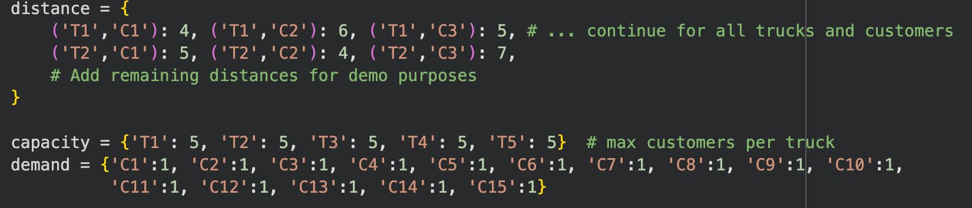
Model Inputs
Trucks: 5 trucks (T1–T5)
Customers: 15 customers (C1–C15)
Truck Capacities: Max 5 deliveries per truck
Customer Demand: 1 delivery per customer
Distance Matrix: Example distances (simplified for demonstration)

Slide 6
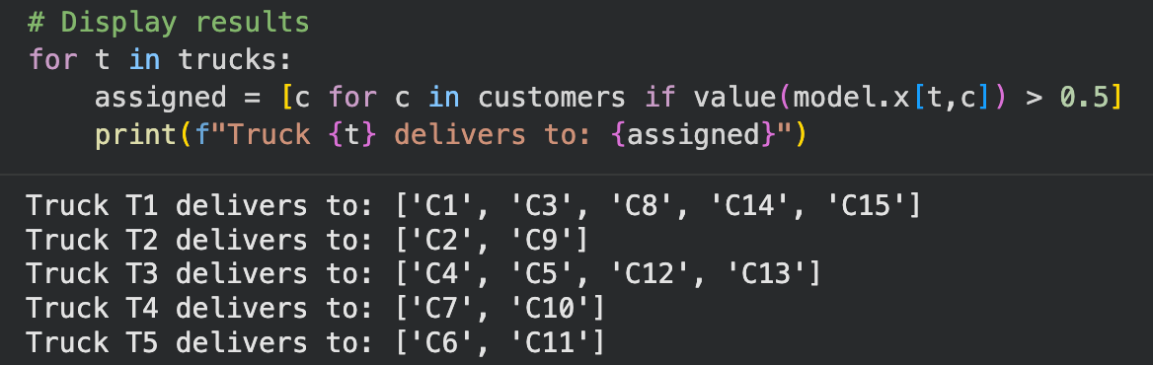
Model Outputs
After solving, the model assigns customers to trucks:
Truck T1 to 5 customers
Truck T3 assigned to 4 customers
Truck T2, T4, T5 assigned to 2 customers

Slide 7
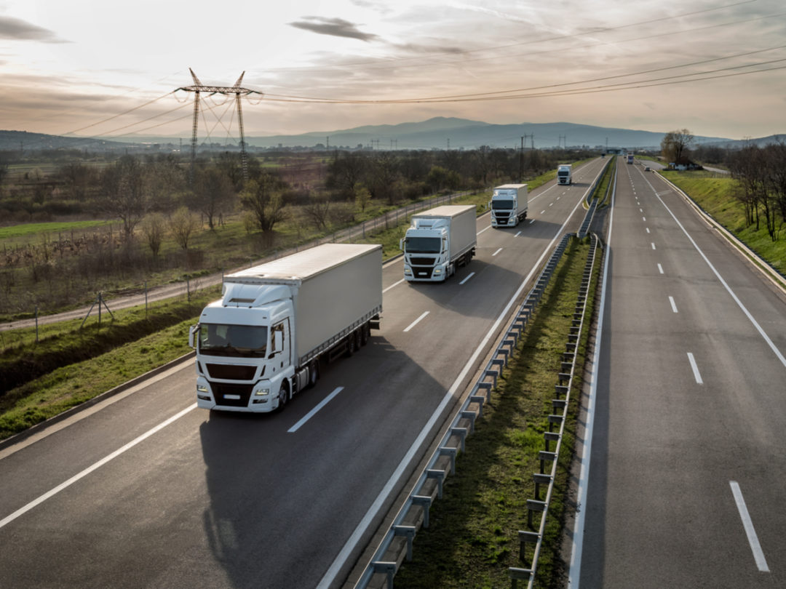
Limitations & Challenges
Distance matrix in demo is simplified
Model does not include:
Time windows
Traffic variability
Truck loads
Weight of packages
Vehicle load constraints beyond max customer count
Multiple order per day
Scaling to 50+ customers may require further decomposition
Somes trucks like T1 and T4 are assigned to more customers than other
Could not be the most optimize case if add more constraints

Slide 8
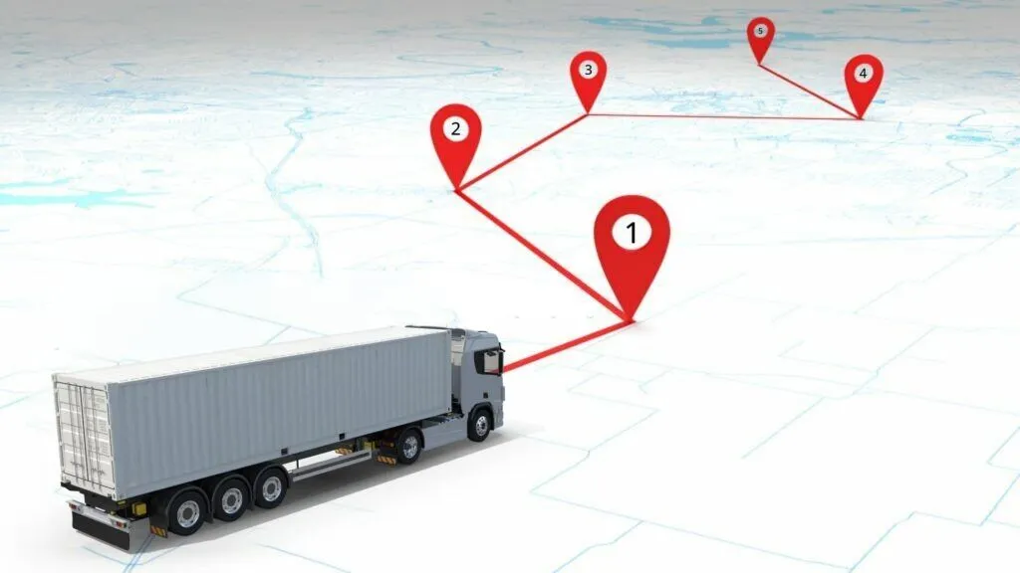
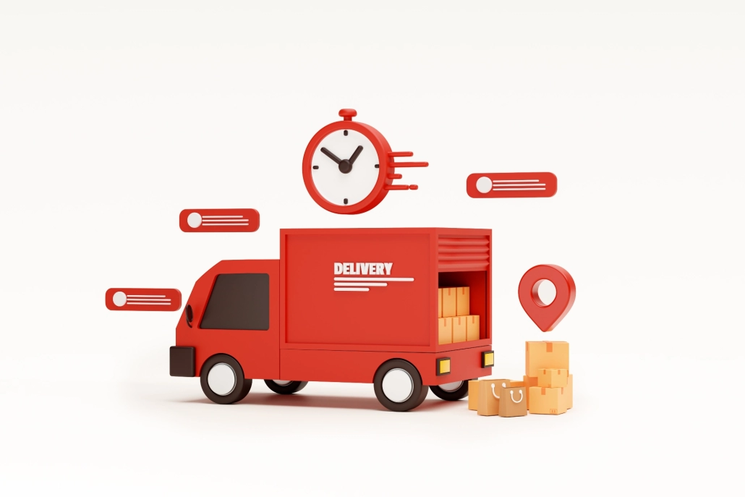
Next Steps
Use real-world distance and travel time data
Incorporate delivery time windows and priority orders
Test larger datasets for scalability
Integrate with real-time routing systems for dynamic updates

Slide 9
Colab Notebook Link
For further info regarding the code for this project:
https://colab.research.google.com/drive/1hI7gGTCGKHOZtHftD00WK_3NLaZemcY7?usp=sharing

Slide 10


